Slide 1
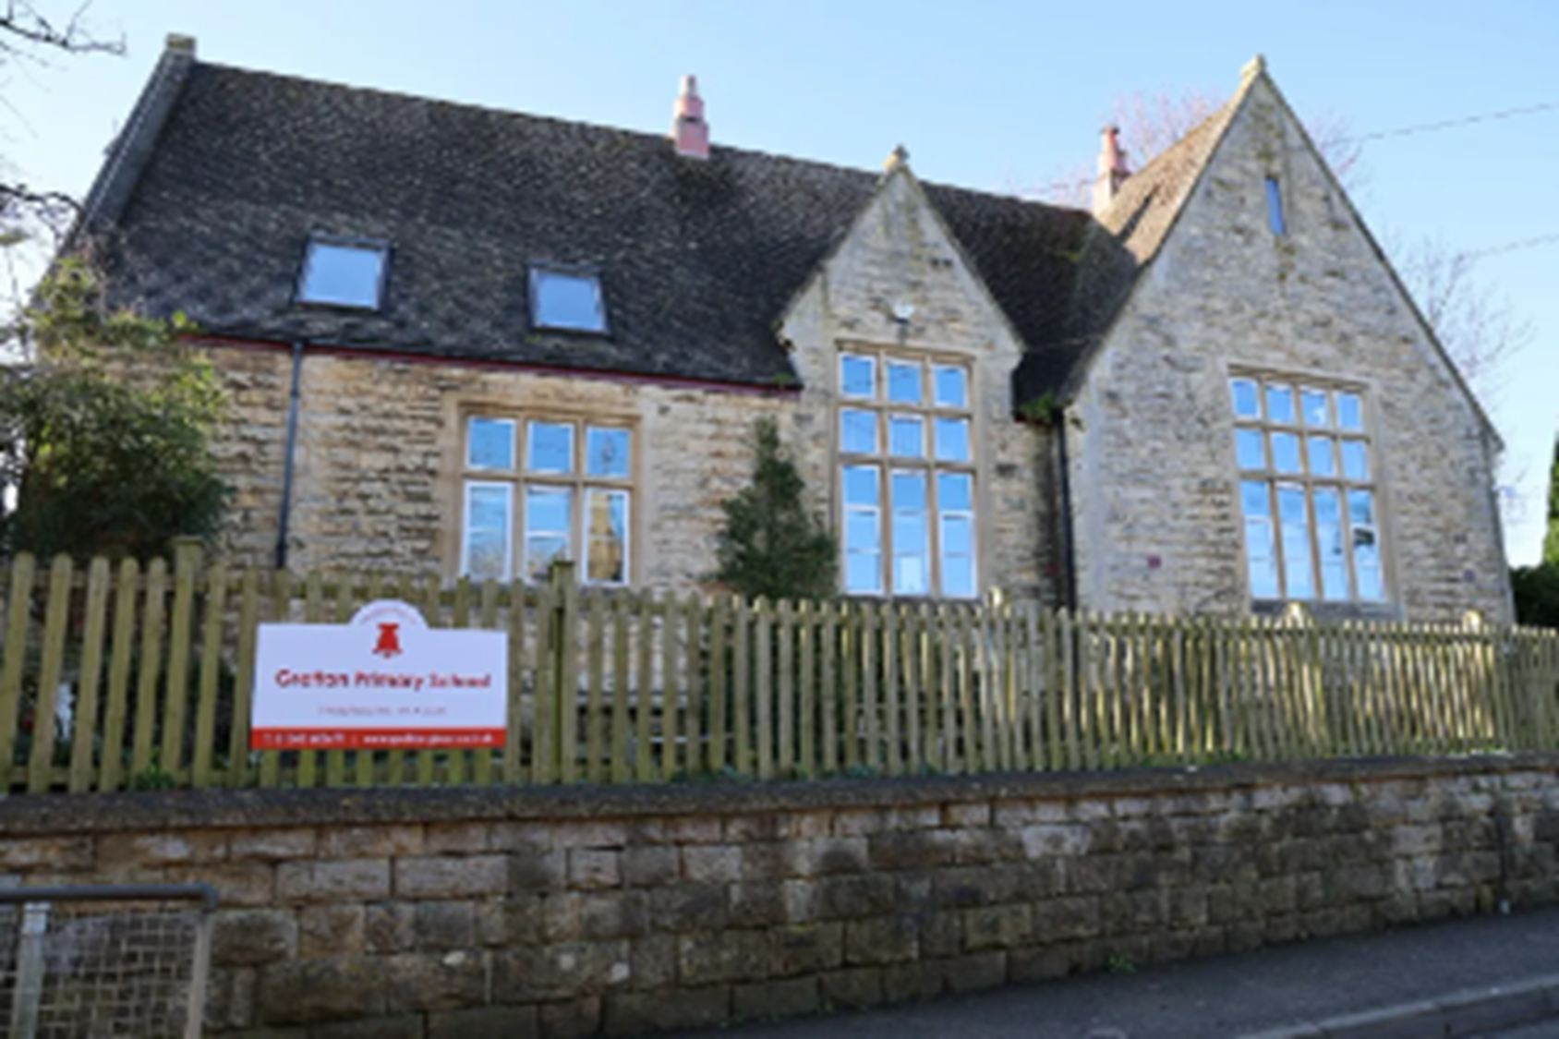
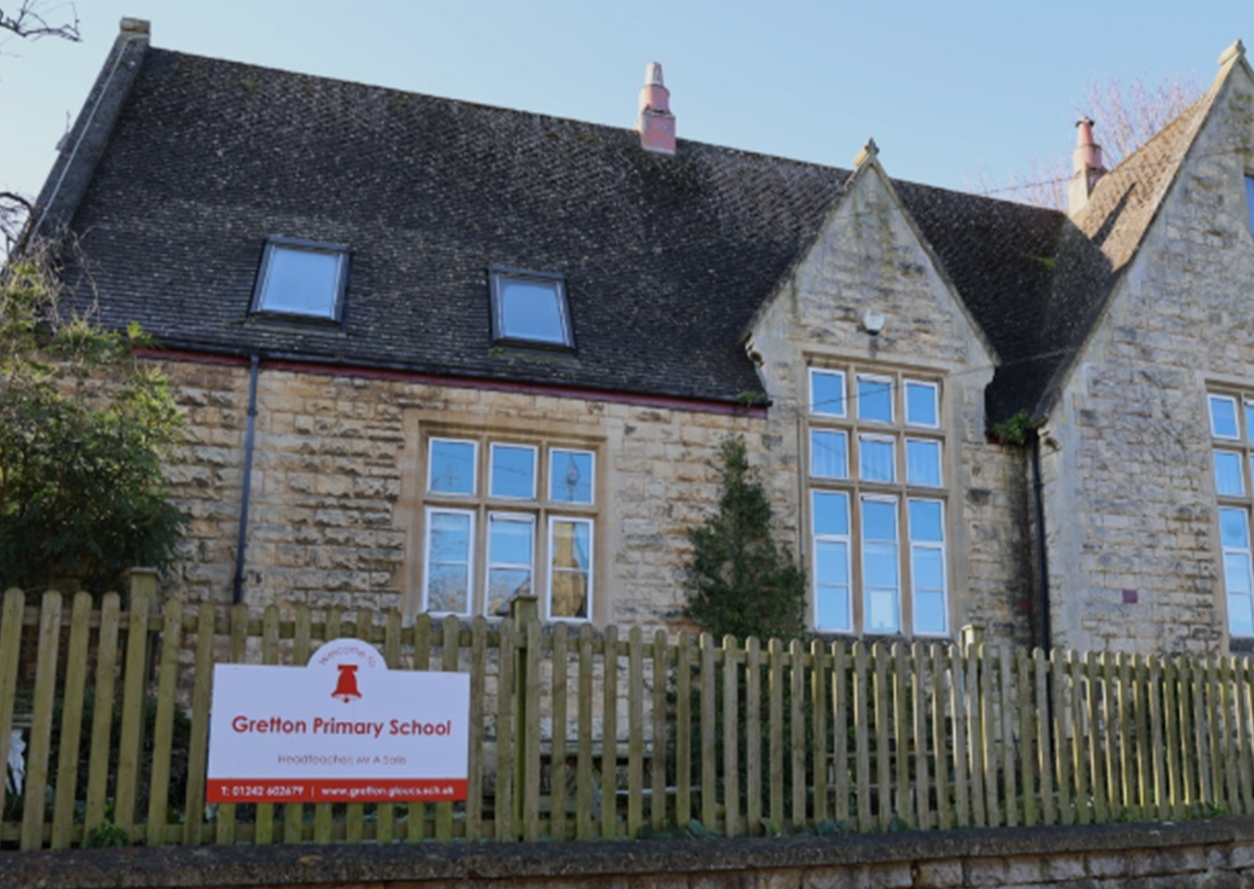
Welcome to Gretton Primary School
Robins Families September 2026

Slide 2

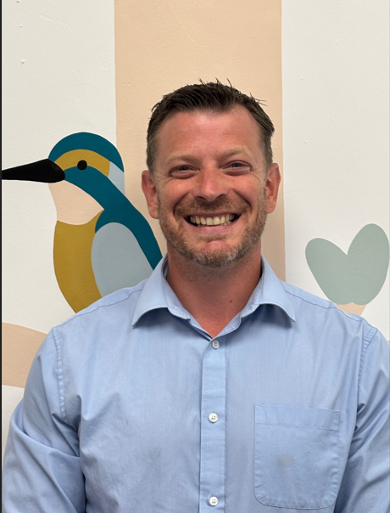
Welcome from Our Head teacher- Mr Sallis

Slide 3
Vision and Values
Our vision aims to support children to be:​
​
Aware - of the world and community around them​
Inspired - by the Wider curriculum​
Mindful - by exploring their mental wellbeing and mental health​
Happy – both in school and in themselves​
Inclusive – able to understand and celebrate the differences that exist​
Growing – support children to be resilient and lifelong learners through a Growth Mindset​
Hardworking – children who always try their best and understand what success looks like.​
Values - Learning and Working together​
​
We believe that school is responsible for the holistic development of each individual childand the community in which they live.​
​
To support children in understanding the values we have adopted our five Golden Rules –​
We are kind and respectful​
We show good manners​
We listen carefully​
We are honest​
We try our best

Slide 4

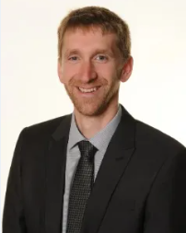
Primary Quality, Education, Standards and Teaching...
enabling pupils and adults to flourish within a caring environment
We are part of a group of primary schools who all belong to the same trust. This allows us to have strategic support and direction, networking opportunities with other schools and continuous professional development.
‘Whilst all the schools gain expertise by work closely together, each school is unique with its own particular character and charm. Our schools achieve high academic standards through the provision of an exciting and engaging curriculum that makes the most of our rich local surroundings’. - PQ
Stephen Dean – CEO

Slide 5

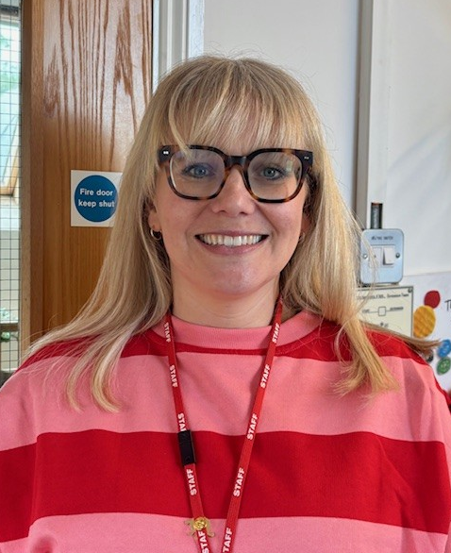
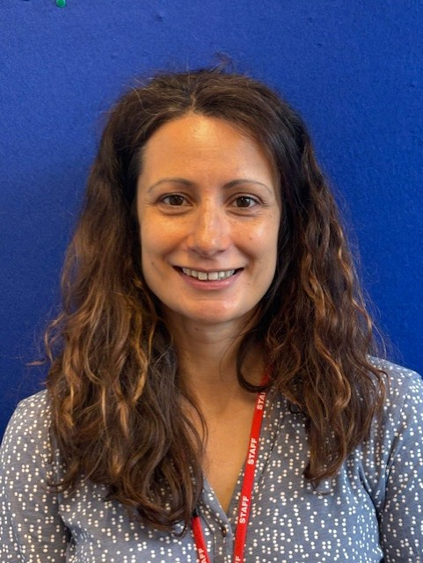
Robins Class 2026-2027
Robins class is made up of up to 15 Reception aged children.
Mrs Patterson – EYFS Lead and Class Teacher
Mrs Woolston – Teaching Partner in EYFS

Slide 6
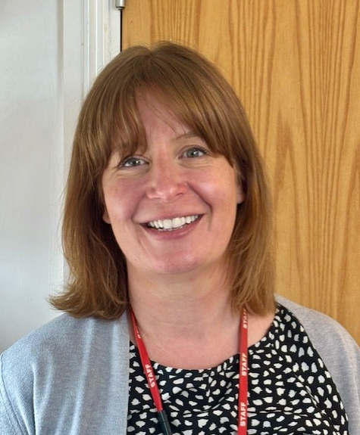
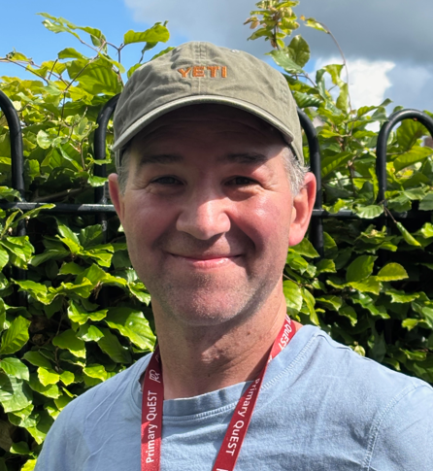
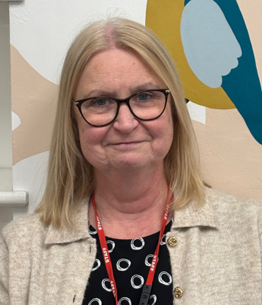
Other Key People for Robins
Mrs Dodd
SENDco and Personal Development Lead
Mr Bridges
Forest School Teacher
Mrs d’Arcy
Office Manager

Slide 7
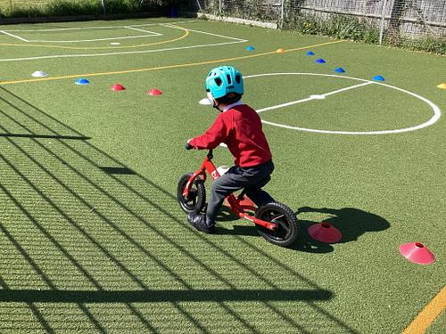
The EYFS
EYFS stands for the Early Years Foundation Stage. We follow the learning and development requirements of the EYFS statutory framework.
There are 7 areas of learning and development:
Three prime areas are particularly important for learning and forming relationships. They build a foundation for children to thrive and provide the basis for learning in all areas.
*Personal, Social, Emotional Development (PSED)
*Communication and Language
*Physical Development
There are also four specific areas, which help strengthen and develop the three prime areas, and ignite children’s curiosity and enthusiasm.
*Literacy
*Mathematics
*Understanding the world
*Expressive arts and design

Slide 8
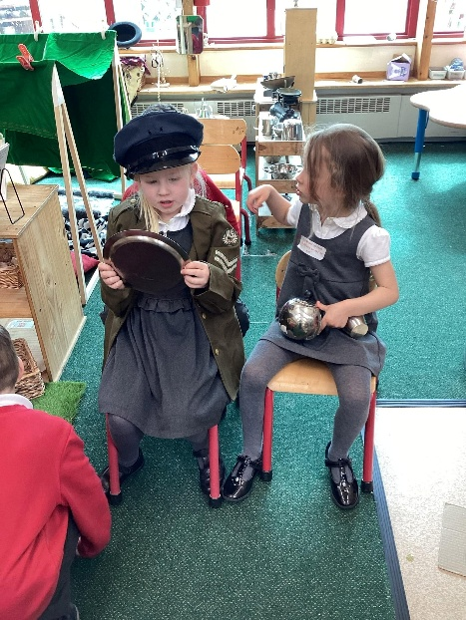
Gretton’s EYFS Curriculum
Our EYFS Curriculum is child centred. It focusses on key knowledge and skills from the seven areas of learning and development using hooks such as key texts, the world around us and children’s interests. It is cumulative, building upon prior experience and is a balance of child initiated, adult initiated and adult led learning opportunities.
Our environment is hugely important and we think of it as the ‘third teacher’ (along with the child and key adults) and it is carefully thought out and planned for. Children work in ‘provision’ every day. Our learning environment is a balance of continuous and enhanced provision.
Alongside children working in provision, we explicitly teach key skills and knowledge in whole class and focus groups e.g. phonics, maths, wonder time and drawing club.

Slide 9
A Typical Day in Robins Class
8:30 – 8:40 | Children come into school and complete a morning task
8:40 | Register
9:00 | Phonics
9:20 | Working in Provision/Reading Practise
10:10 | Break time with Kingfishers class (Y1/2)
10:25 | Snack
10:35 | Drawing Club
11:00 | Working in Provision
11:45 | Story
12:00 -12:50 | Lunchtime
12:50 -1:10 | Register and Maths
1:10 – 2:40 | Working in Provision/ Wonder Time/ PE
2:40 – 3:00 | Assembly/Story/Show and Tell
3:10 | Home Time

Slide 10


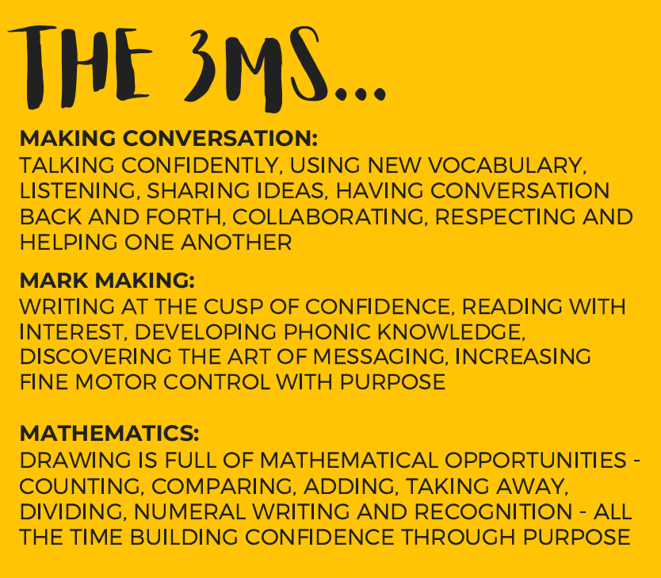

Little Wandle, Drawing Club, Mastering Number

Slide 11
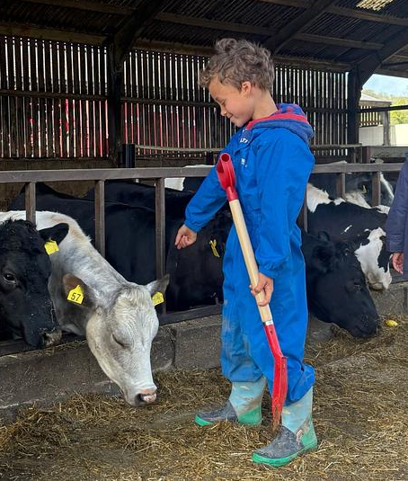
Home/School Communication
We communicate in a variety of ways;
*Class Dojo – Please download the app and look out for an emailed login.
*Emails from ‘admin’
*School text reminders
*The School Website
*Paper letters (these will also always be emailed out)
*Face to face conversations
*Parents evening meetings 2x per year
*A written report in the Summer term

Slide 12
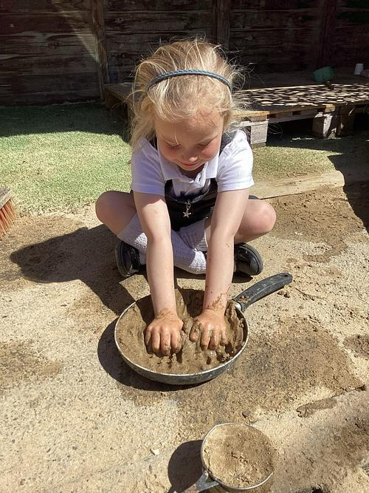
Transition to School
Starting school can be a really daunting time for children and parents alike and we aim to make this transition as smooth as possible for you and your child.
We know that strong relationships are the MOST important factor.
We know that emotional security comes before any academic learning - children need to feel safe, secure and connected before they can learn well
With this in mind, transition to school has already begun.
Communication with preschool settings
This evening’s presentation
Preschool visits
School stay and play (or drop off!) afternoons
Home visits
Gradual start

Slide 13
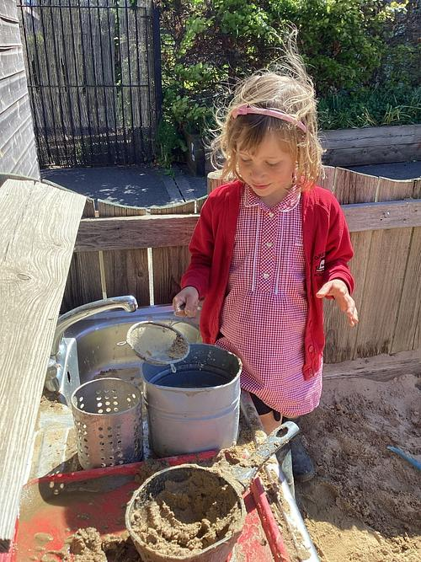
Transition to School - Supporting Independence
Encourage your child to:
*Use the toilet independently
*Wash hands
*Manage belongings (put something back once they have used it etc)
*Put shoes and coats on independently – please no laces until they can tie them themselves
*Sit for short periods
*Take turns
*Ask for help
*Separate from you confidently

Slide 14
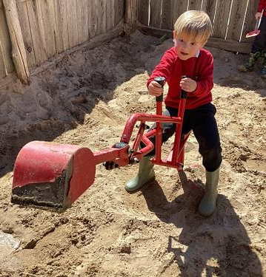
Transition to School - Arrangements
Mrs Patterson to visit Preschool settings - June
Stay and play/ Drop off afternoons – Tuesday 16th June and Wednesday 24th June
Home Visits – Wednesday 2nd and Thursday 3rd September
Start School – Friday 4th September (9am – 11:50am)
Week 2 – Monday 7th to Friday 11th September (8:30/8:40am – 1:15pm)
Week 3 – Monday 14th September – Children in full days

Slide 15
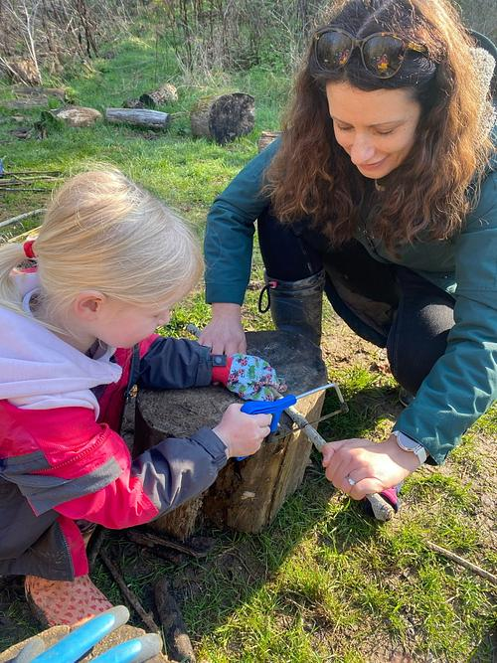
Nuts and Bolts – Daily Essentials
*A Gretton book bag
*A small/medium rucksack with spare clothes in every day
*Wellies that can stay in school (named)
*A coat
*A drink bottle filled with water

Slide 16
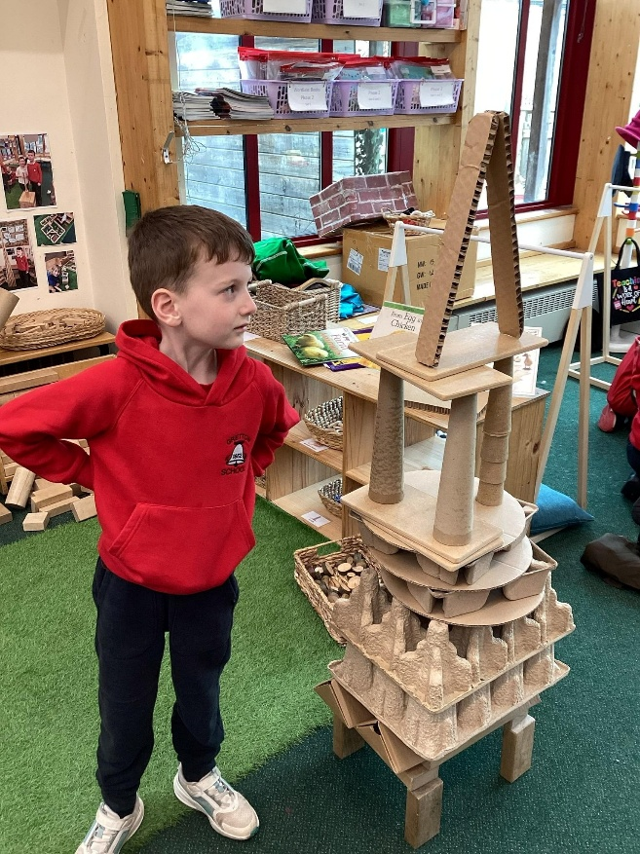
Nuts and Bolts
Lunches – These are free to all Reception to Year 2 children. They are ordered daily and a seasonal menu is available on our website
Snack – We have fruit provided daily. If your child would prefer to bring in fruit or vegetables from home to eat that is fine.
Milk – Please see information in your pack
Early birds – Children can be dropped off at 8am. This costs £3 per session and will need to be paid in advance.
Parent Pay – See information in your pack

Slide 17
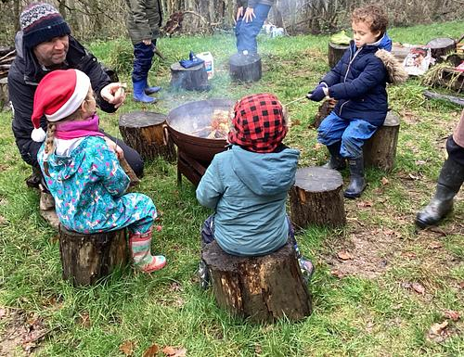
Nuts and Bolts - Uniform, PE and Forest School
Gretton labelled uniform can be purchased from ‘my clothing’ online or from the Evesham school uniform shop (cardigans, jumpers, book bags etc)
We will have PE lessons during the week and your child can come dressed in PE kit on that day.
We will have Forest School once a week. We will let you know when this will start. Your child will need waterproof trousers and a waterproof coat (or all in one) plus other items depending on the weather.
There is a list of uniform in your packs.

Slide 18
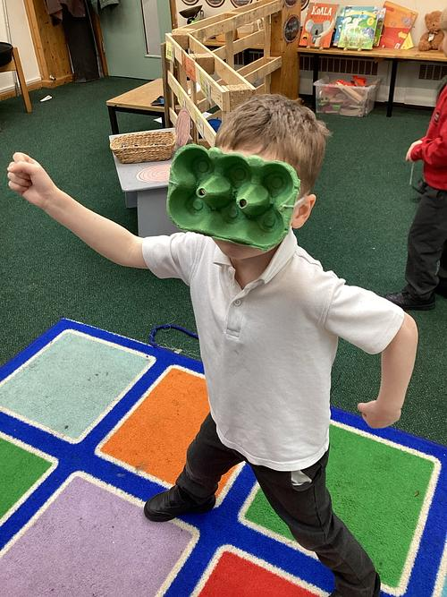
How Can you Help Us?
Volunteering
Hearing readers
Helping with forest school
Helping on school trips
Things we always need
-Junk modelling materials (cardboard boxes like cereal boxes etc)
-From time to time I will ask if you have anything at home that is unwanted e.g. white pillowcases

Slide 19


